Slide 1
jQuery
CS/IT 490 WD, Fall 2013

Slide 2
Breakdown
What is jQuery?
Download jQuery
Jquery Basics

Slide 3
What is jQuery?
Jquery is a JavaScript library that adds a LOT of functionality, as well as shortens up the traditional JS syntax.
Instead of
document.getElementById( “name” )
you can use:
$( “#name” )
Also has animation functions, AJAX functions, etc.

Slide 4
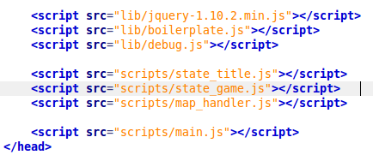
Download jQuery
Download jQuery from:
http://jquery.com/
Save it to your hard-drive and use it in any projects with JavaScript.
You include it like a standard JS file:
Jquery file

Slide 5
Jquery Basics
Selecting Elements by ID, Class, or Type
Modifying an element's CSS
Modifying an element's InnerHTML
Modifying an element's Value
Appending elements to your webpage
Adding and removing classes from an element
Binding function callbacks
  On click, on change, etc.
Special Effects

Slide 6
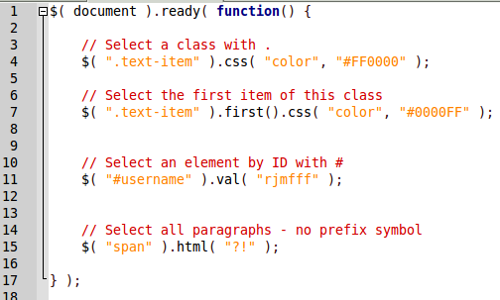
Selecting Elements by ID, Class, or Type
You can select all items of a given class with the dot operator .
This will return an array of items, since there could be more than one element with that class.

Slide 7
Selecting Elements by ID, Class, or Type
You can select a single element by its unique ID with the pound sign #.

Slide 8
Selecting Elements by ID, Class, or Type
And you can select an array of all elements of a given type without any special prefix.

Slide 9
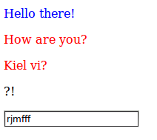
Selecting Elements by ID, Class, or Type
Here, we're modifying the color CSS property via the .css function.
Here, we're changing the value of the input box with the .val function.
And we can add HTML inside a tag with the .html function.

Slide 10
Binding function callbacks
You can set certain functions to happen when an element is clicked, changed, or other things.
Select the item, then call .click(). The ARGUMENT of your click function will be a new function – the callback.

Slide 11
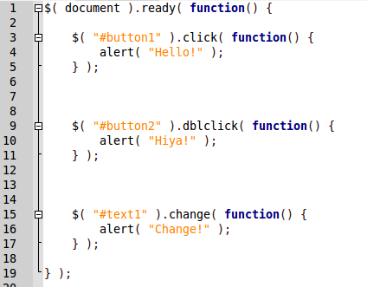
Binding function callbacks
When the button is clicked, it will display the message.
When the button is double-clicked, it will display the message.
This will display a popup once the user has changed the text box, and the text box has lost focus.

Slide 12
Modifying an element's CSS
To modify the CSS of an element, or elements, you can use the .css() function.
The first argument is what style to update, and it matches your standard CSS style names.
The second argument is what to set it to.
If you call just .css() with the first argument, the return value will be that css style's current value.

Slide 13
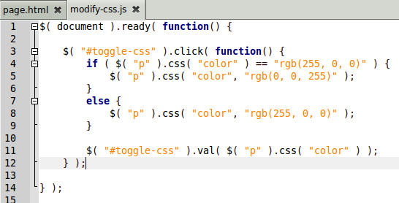


Modifying an element's CSS

Slide 14
Modifying an element's Inner HTML
You can retrieve any markup from within an element's open and close tags with .html().
You can also replace the internals of that element by adding an argument inside.

Slide 15
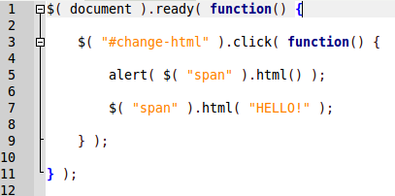
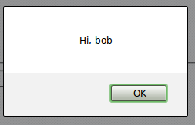


Modifying an element's Inner HTML

Slide 16
Modifying an element's Value
If a tag has a value attribute (like an input element), you can get its current value with .val()
You can also change its value by specifying an argument.

Slide 17
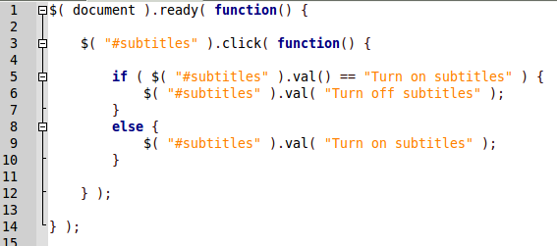


Modifying an element's Value

Slide 18
Modifying an element's attributes
Element tags might have various attributes beyond the value and style.
ID, name, etc.
You can access these with the .attr() function
// get its ID
$( “#myItem” ).attr( “id” );
// change ID
$( “#myItem” ).attr( “id”, “newID” );

Slide 19
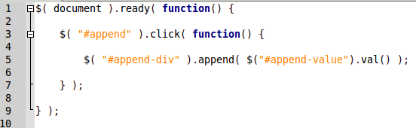

Appending elements to your webpage
You can use the .append() function to add HTML to the end of an existing element.

Slide 20
Adding and removing classes from an element
You can dynamically change the styling of an element by using .css()...
but you can also add and remove classes from an element, which is much cleaner.

Slide 21
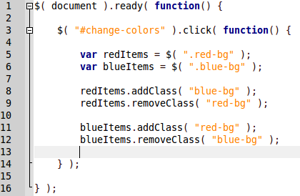
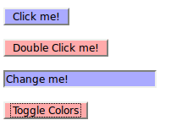
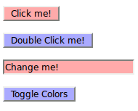
Adding and removing classes from an element

Slide 22
Special Effects
Want to have a slideshow? A picture disappears and another re-appears?
You could use .css() to quickly set display:none, but it's kind of rough.
Let's use the Slide and Fade functions!

Slide 23
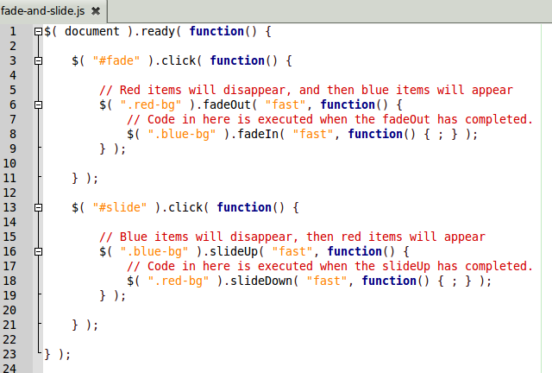
Special Effects

Slide 24
References
-

